Slide 1
Software Engineering
Java Unit Testing with Junit
CS 1530
Summer 2020
Instructor: Sohel Sarwar
University of Pittsburgh
Lecture 14

Slide 2
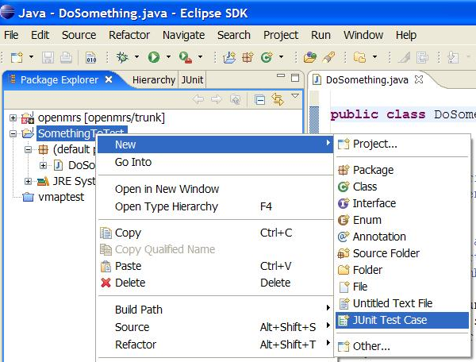
JUnit and Eclipse
To add JUnit to an Eclipse project, click:
Project → Properties → Build Path → Libraries → Add Library... → JUnit → JUnit 5 → Finish
To create a test case:
right-click a file and choose New → Test Case
or click File → New → JUnit Test Case
Eclipse can create stubs of method tests for you.

Slide 3
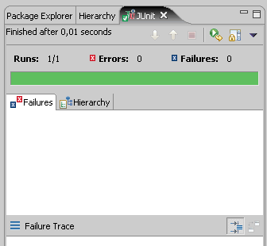
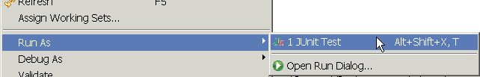
Running a test
Right click it in the Eclipse Package Explorer at left; choose:
Run As → JUnit Test
The JUnit bar will show green if all tests pass, red if any fail.
The Failure Trace shows which tests failed, if any, and why.

Slide 4

Code Coverage
Code
Coverage
Code coverage is a measure used to describe the degree to which the source code of a program is executed when a particular test suite runs
Code Coverage is classified as a White box testing

Slide 5
Code Coverage Benefits
Code
Coverage
Identify untested part of codebase
Improve the Quality by improved test coverage
Identify the redundant/dead Code
Identify testing gaps or missing tests

Slide 6
Code Coverage Workflow
Code
Coverage
Writing test cases and execute them
Finding areas of code not covered using Code Coverage Tool
Creating additional tests for identified gaps to increase test coverage
Determining a quantitative measure of code coverage

Slide 7
The Emma Code Coverage Tool
Home page:
http://emma.sourceforge.net/
Quick start introduction page:
http://emma.sourceforge.net/intro.html
Download page:
http://sourceforge.net/projects/emma/files/
Emma sample reports page:
http://emma.sourceforge.net/samples.html
Emma FAQ page:
http://emma.sourceforge.net/faq.html

Slide 8
Downloading and Installing Emma
Go to the download page:
http://sourceforge.net/projects/emma/files/
Get the file emma-2.0.5312-lib.zip in the emma-release directory.
The download starts automatically after a short sourceforge advertisement.
Unzip the emma-2.0.5312-lib.zip file and put the file emma.jar in the directory with the code.
You can put the file elsewhere as long as you include the directory in the java class path using the “–cp” option.

Slide 9
Test-driven development
Unit tests can be written after, during, or even before coding.
test-driven development: Write tests, then write code to pass them.
Imagine that we'd like to add a method subtractWeeks to our Date class, that shifts this Date backward in time by the given number of weeks.
Write code to test this method before it has been written.
Then once we do implement the method, we'll know if it works.

Slide 10
Test-driven development
We will create a Calculator class in Java with the following elements:
An Adder Interface
A Subtractor Interface
An add public method --- Just the skeleton
A subtract public method --- Just the skeleton
A multiply private method --- Just the skeleton
We will create a corresponding Test Class
We will flesh out the methods in the Calculator class

